Slide 1
Theory & Practise: Sustainable use of water- a European Challenge
Grundtvig Learning Partnership
Duration: August 2013 -June 2015

Slide 2
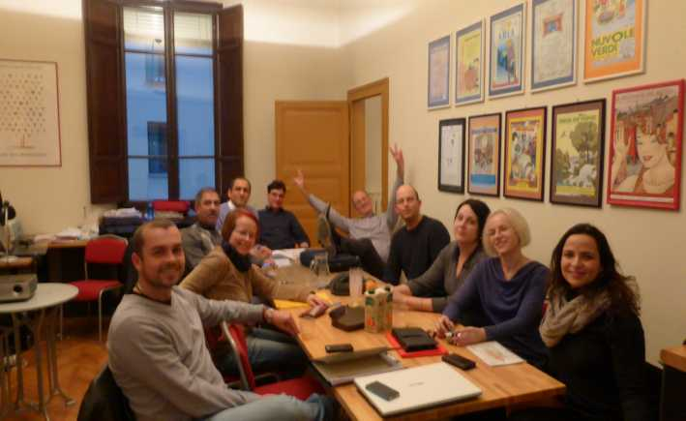
Partners
OBUK (Germany)
Tabanca Pequena (Portugal)
Centrum Kszatalcenia Ustawiznego (Poland)
Scuola Universitaria Professionale della Svizzera Italiana (Swiss)
Associazione Universita Verde die Bologna (Italy)
Dyarbakir Zirai Mücadele Arastirma Müdürlügü (Turkey)

Slide 3
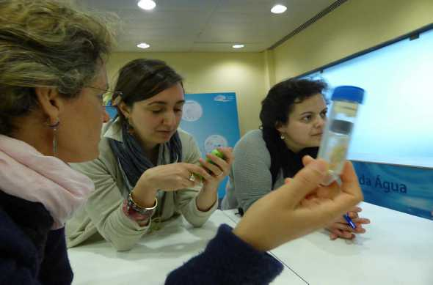
Aims of the Project
Improvement of waterconsumption in our instititutions.
Educational level: Improvement of our educational work through learning new methods from each other, which deal with water.
Knowledge Extension through visits of „water places“ in the other countries and theoretical inputs related to water.

Slide 4
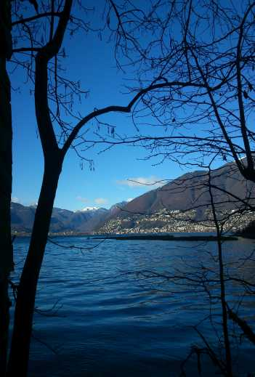
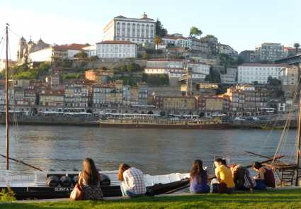
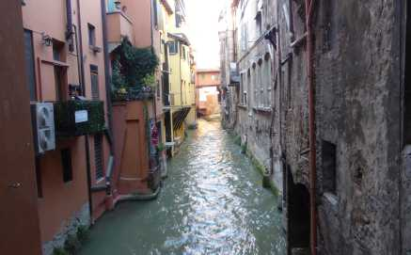
Partnermeetings
During the project term in each country of the partners one meeting with all organisations:
October 2013: Berlin
December 2013: Swiss
April 2014: Portugal
September 2014: Poland
December 2014: Bologna
April 2015: Turkey

Slide 5
Working tools/methods
Timetable
Protocolls of every partnermeeting
Only office
Website
E-mail contact
Skypeconferences

Slide 6
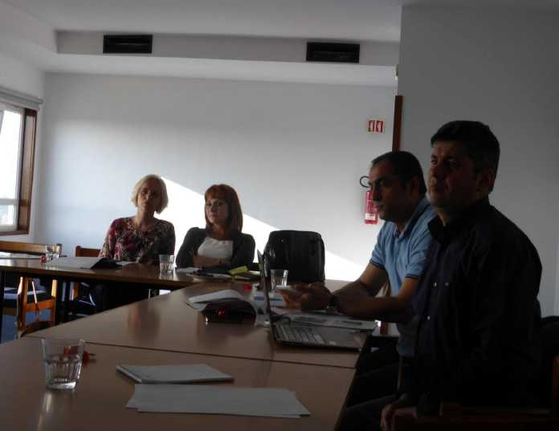
Individual Agendas and Best Practise Examples
Example OBUK

Slide 7
Individual Agenda
1) Office and Moderation Materials
2) Homewares (duvets and covers)
3) Foods consumption
4) Direct use of water
5) Traveling
6) Training Workshop

Slide 8
Office materials
We increased our use of second hand and recycling paper.
Now 90% of the white new paper has 100% recycling quality with the german certificate “Der Blaue Engel” and is Process Chlorine Free (PCF).
Beside that we are using waste-paper from a print shop for draft-printing
We are using 50% second hand office computers from a refurbish-project.
The new information leaflet of the guest house is printed on 100% recycling-paper with “Der Blaue Engel”-label form a ecological print shop.

Slide 9
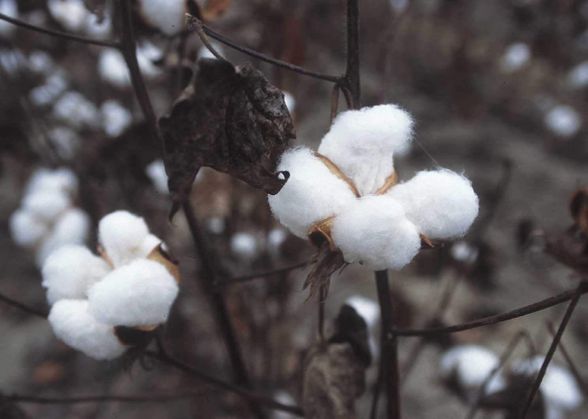
Home-wares
Deep research about the sustainability of home-textiles.
Focus on cotton as water-intensive product.
Topic included in water-exhibition.
Purchased new bedding textiles made of...
African Cotton (project for small farmers in Africa)
Tencel (Austrian sustainable Viscose fiber-product)
Checked out detergent we use:
Found best practice for dishwasher and washing machine. Made operating instructions for both.
Energy very important as well for water-question.

Slide 10
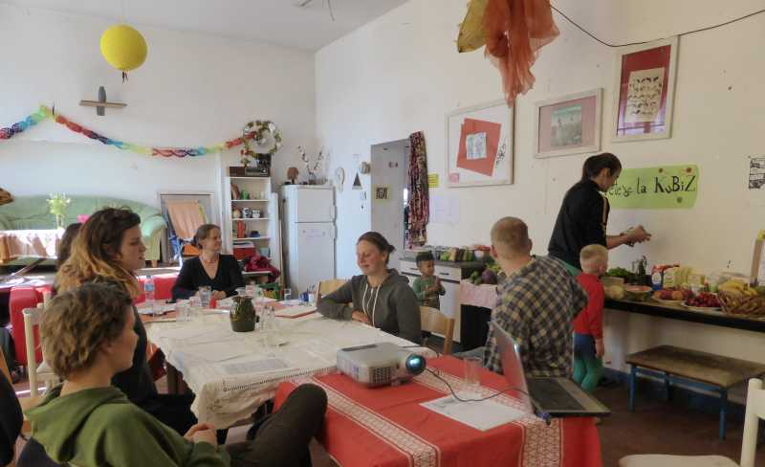
Food Consumption
Made research about the connection between water-sustainability and food-production.
Developed and tested a course- curriculum.

Slide 11
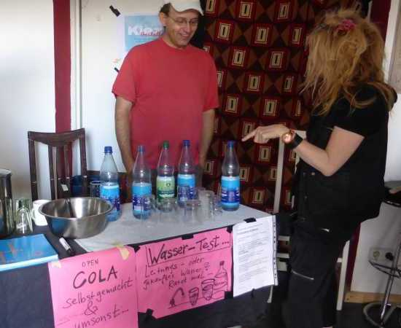
Food Consumption
Research about home-carbonation-system. Bought a best-practice-machine and installed it in the guest house.
Water-Test and Open-Cola presentation at our KuBiZ summer-festival
Opened up a small
“cupboard-shop” with
sustainable fair trade
product for our guests.

Slide 12
Food Consumption
Offering regional apple-juice during the seminars/workshops
An information list for cooking teams about food and virtual water consumption with some practical advices to cook.
Cooking workshop about water and sustainability offered to external institutions.

Slide 13
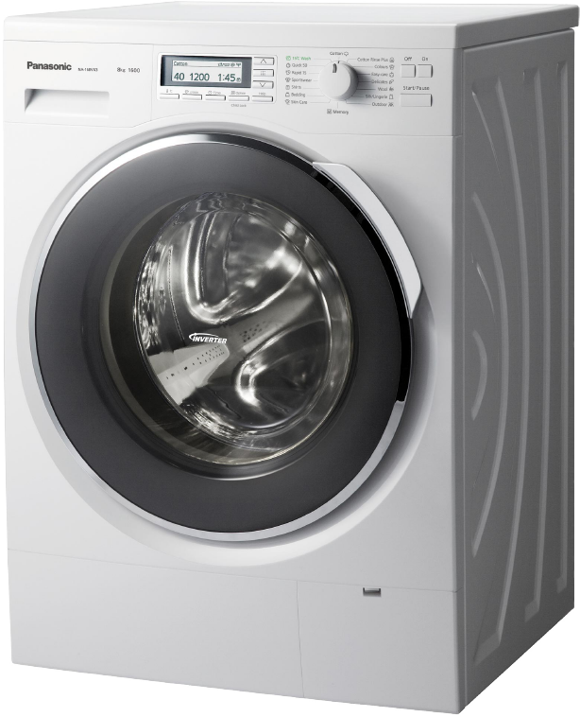
Direct use of water
We did reduce the use of water and energy for laundry by adjusting the ideal program for each kind of laundry and sorting it.
Problem: Different user profiles in the years make the evaluation difficult. Water usage differs very much on the number of people staying in the house.
By now just recorded and evaluated the counters.

Slide 14
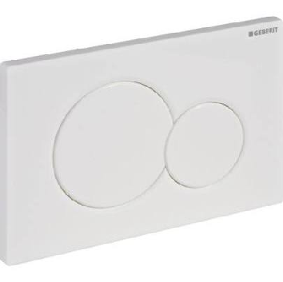
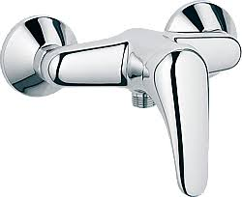
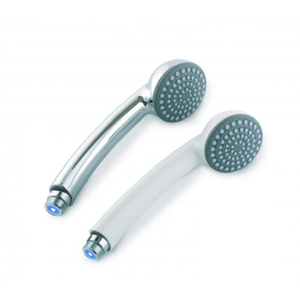
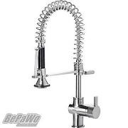
Direct use of water
… but the installations in the guest house are new and in a modern (water saving) state.

Slide 15
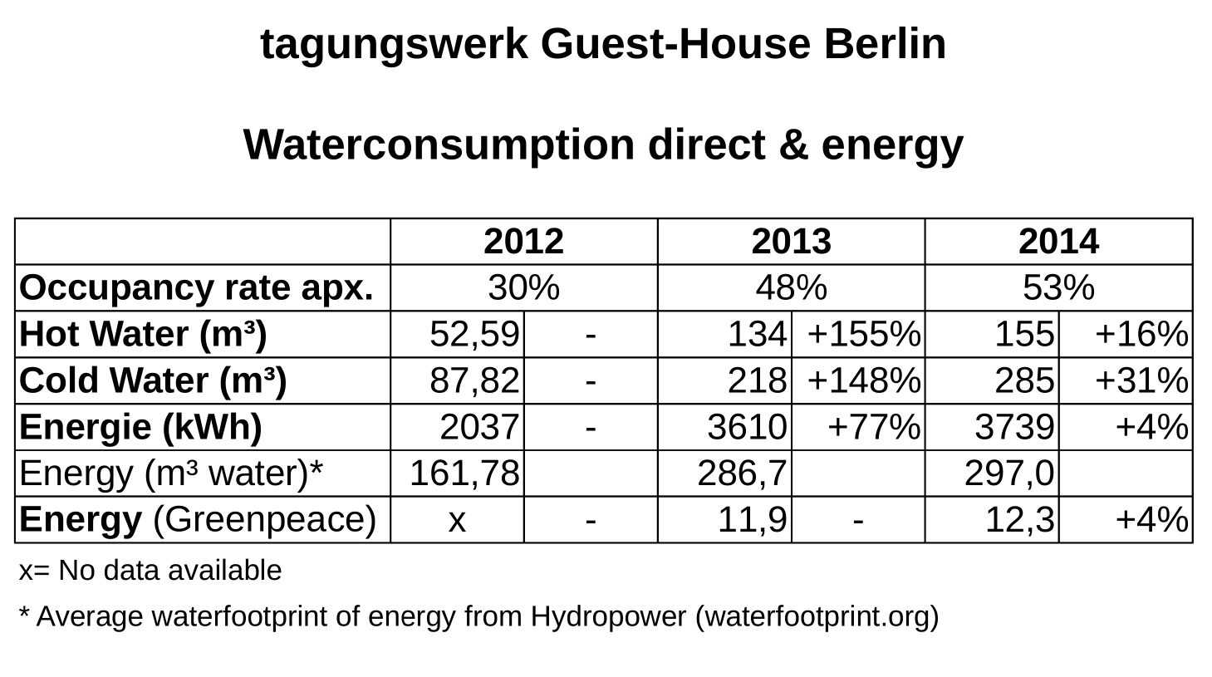
Direct use and energy allocation

Slide 16
Evaluation of the allocation
Evaluation showed that the water- and energyconsumption is increasing with the occupancy-rate of the guesthouse from 2012 to 2013.
The strong increase from 2012 to 2013 is the result of more overnight bookings and bigger groups using showers etc. The comparison to the electricity consumption verifies this theory.
The waterfootprint of energy is sometimes much higher with renewable (eco-) suppliers, when they sell mainly energy from big hydropower dams.
But our supplier greenpeace energy sells only flow-hydropowerplants (91%) in Austria and Germany that are not daming the river. 9% they produce by own windenergy mills.

Slide 17
Travelling
Established a bus and train-first choice policy:
Flights can only be used for tours with a train/bus-travel-distance of more then 10 hours (one way).
We have to prefer sustainable airlines listed on the the airline-index of “atmosfair”.
(https://www.atmosfair.de/en/)

Slide 18
Sustainable water training workshop
This training lasts from 13.3.-22.3.2015
Universita Verde and Tabanca Pequena are partners (who also joined the water learning partnership) and as another partner Asociatia Quantic from Romania.

Slide 19
Sustainablility and water exhibition
We designed an exhibition on our topic sustainability and water with results from the partnership project and presented it first on the KuBiZ-festival and now continuously in the building.
The exhibition is now translated into English as well for common use in the project. The layout-data made on Adobe InDesign CS5.5 is available for all partners.
The exhibition can be extended by partners

Slide 20
Open Tasks
Improvement of direct water consumption:
Install information boards in the guest-house, with advices how to use the washing-machine, dishwasher and the showers in the most effective way (related to waterconsumption and pollution of water).
Standardize the cooking workshop and implement this in schools.

Slide 21
Dissemination of the Project results
Guidebook, including:
Introduction of our organisations
Theoretical backgrounds (information material, our inputs during the meetings, etc...)
Individual Agendas
Best Practice Examples from each organisation
All pedagogical approaches

Slide 22
Dissemination of the project results
Public events to present the project results
in april/may 2015
Website
https://sustainableuseofwater.wordpress.com/2013/10/

Slide 23
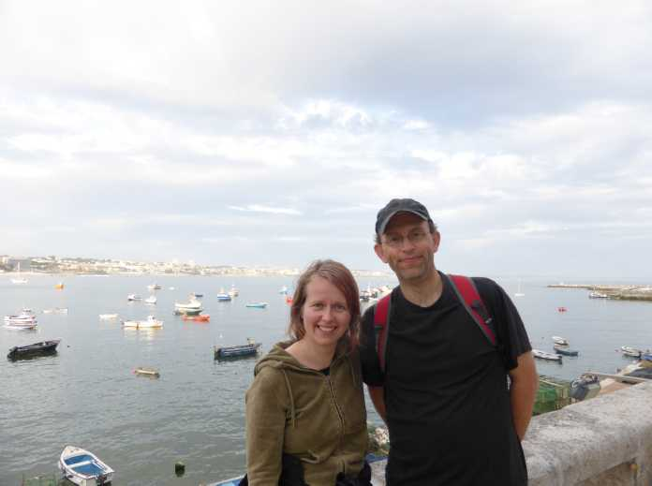
THANKS FOR YOUR ATTENTION …

