Slide 1

Water is life
Challenges for sustainable
water-policies
Introduction

Slide 2

The World and the water
71% of the worlds surface is covered by water
Only 0,3 - 0,5% of the water resources are potential available as drinking water
97% is salt-water
2,5% of the fresh water is frozen

Slide 3
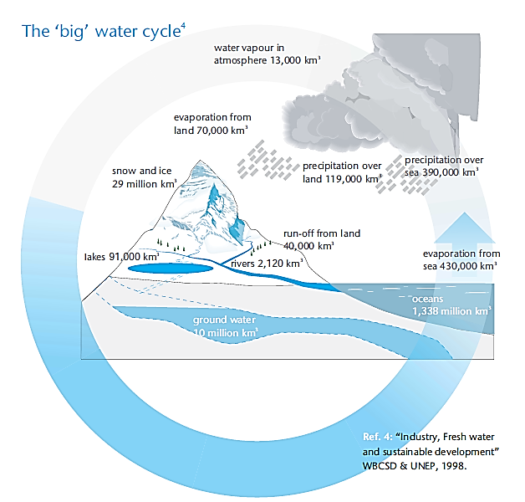
The „big“ water cycle

Slide 5
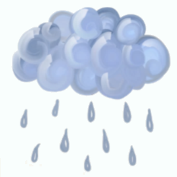
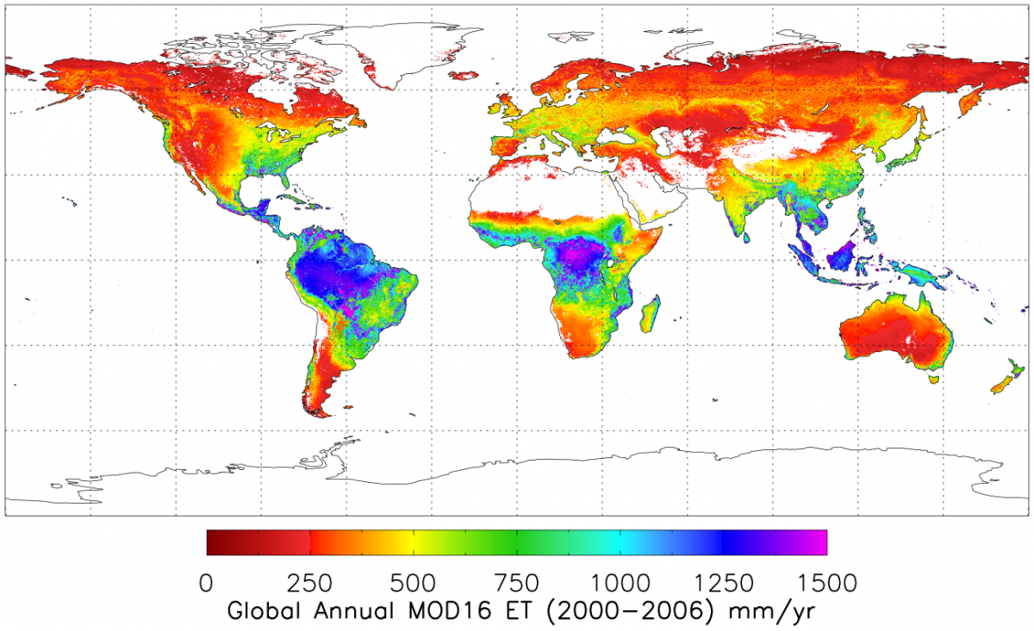
Dispersion - global precipitation
Source: http://www.ntsg.umt.edu/project/mod16

Slide 6
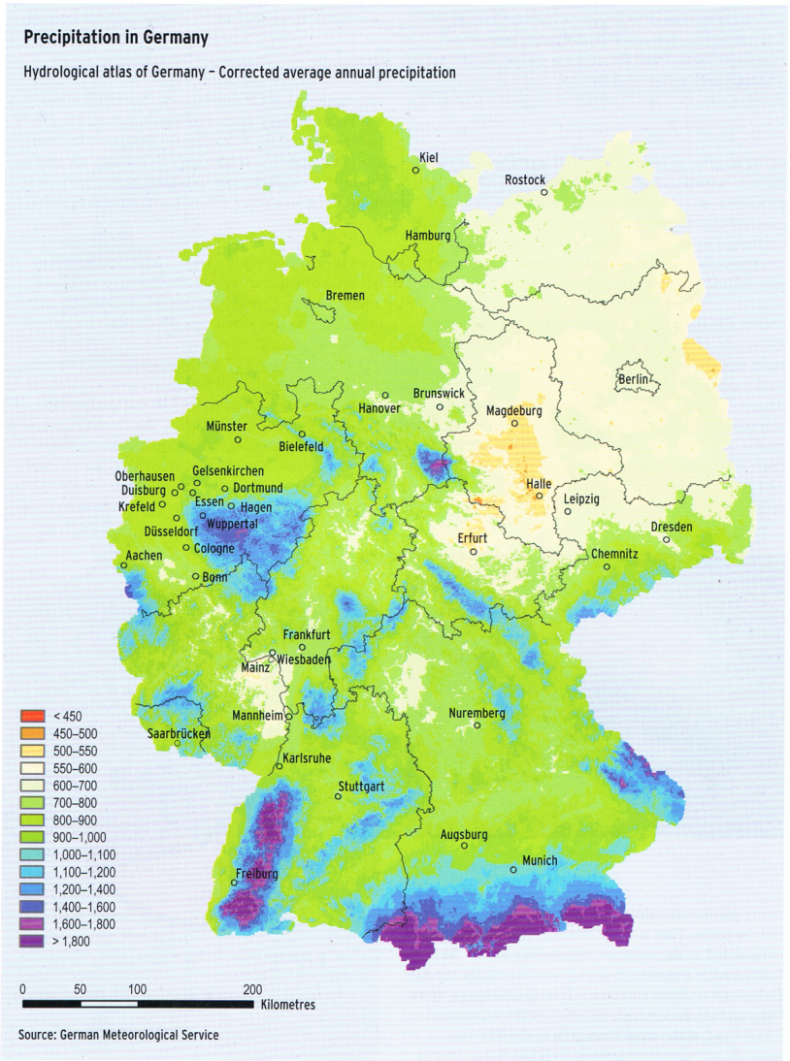
German
details…
The local focus shows big diffences in the regions.

Slide 7
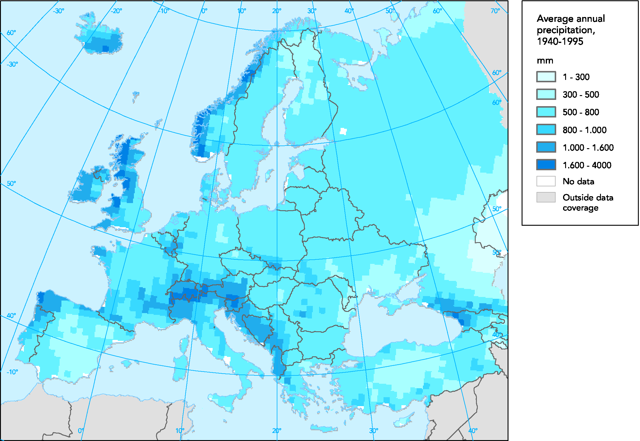
In Europe
Source: European Environment Agency, 2009

Slide 8
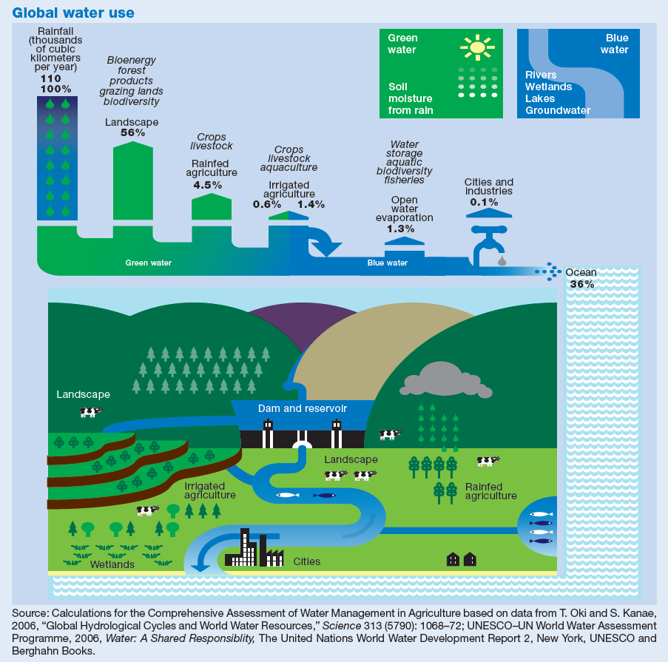
The use of water
70% of blue water is used for agriculture
40% of the worldwide produced crops are grown on irrigated

Slide 9
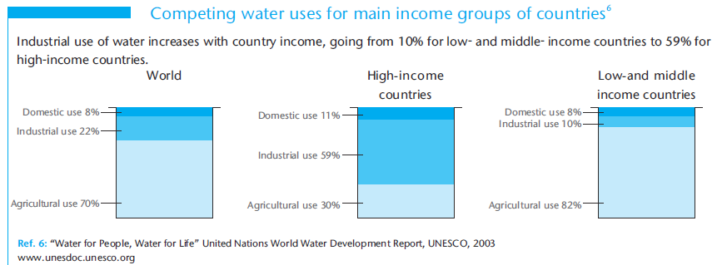
The use of water related to income

Slide 10

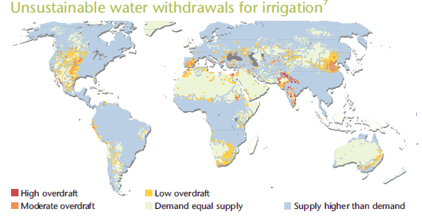
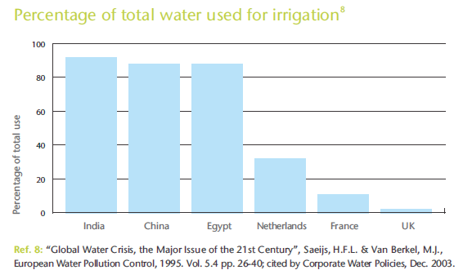
Irrigation
Source: “Ecosystems and Human Well-being: Synthesis” Millennium Ecosystem Assessment, 2005.

Slide 11
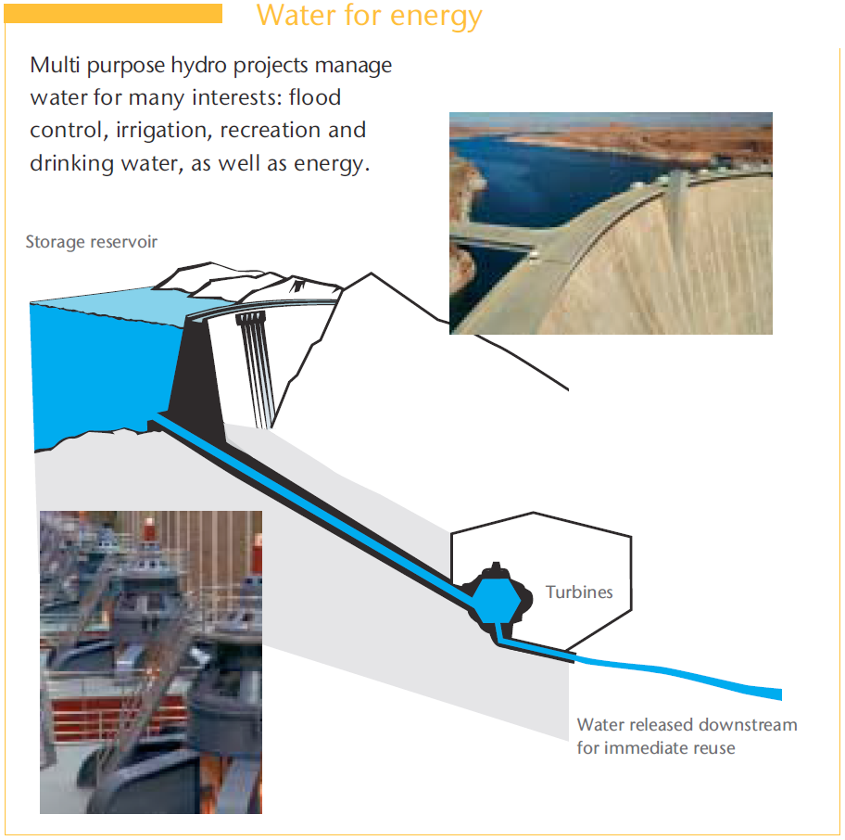
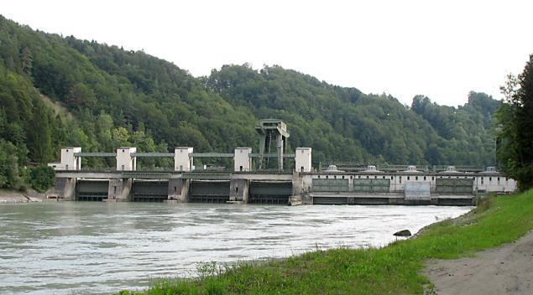
Industy - Energy
Source: Water - fact and trends, WBCSD.org, Aug. 2005

Slide 12
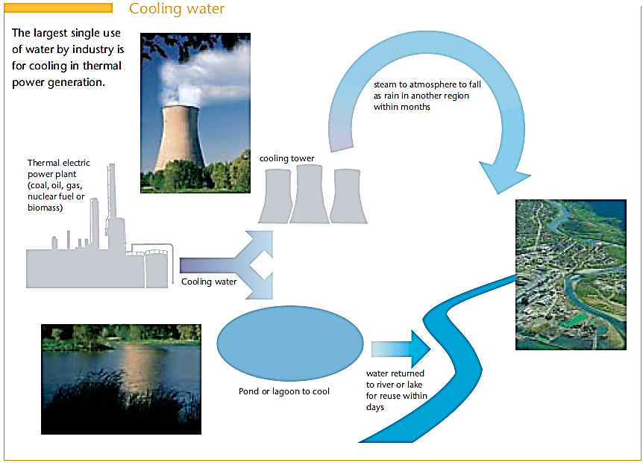
Industy - Energy
Source: Water - fact and trends, WBCSD.org, Aug. 2005

Slide 13
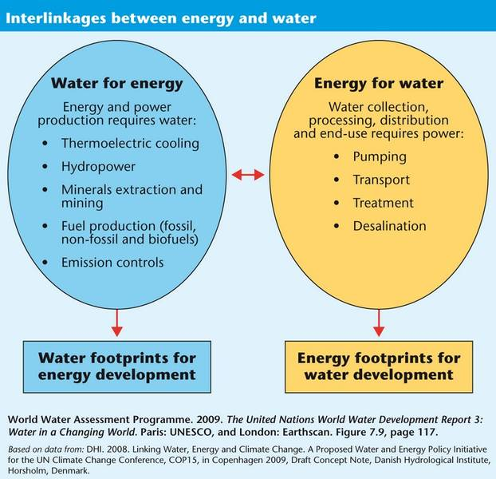

Slide 14
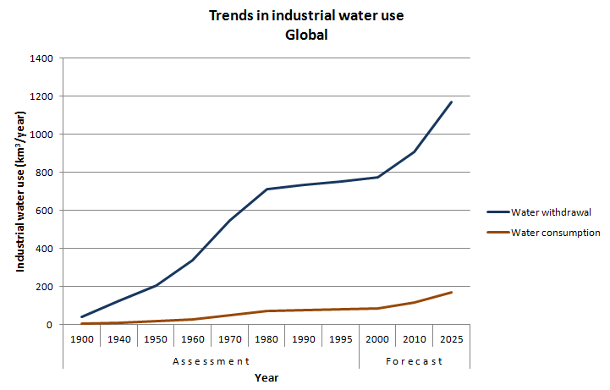
Global Industrial water-use
Pengguanaan Air Bersih di Industri. Shiklomanov, Igor A. (1999) World Water Resources and Their Use, a joint State Hydrological Institute (SHI) and UNESCO product

Slide 15
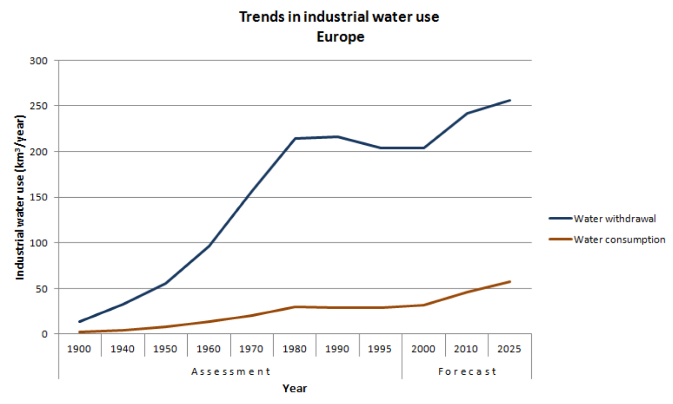
European Industrial water-use
Pengguanaan Air Bersih di Industri. Shiklomanov, Igor A. (1999) World Water Resources and Their Use, a joint State Hydrological Institute (SHI) and UNESCO product

Slide 16
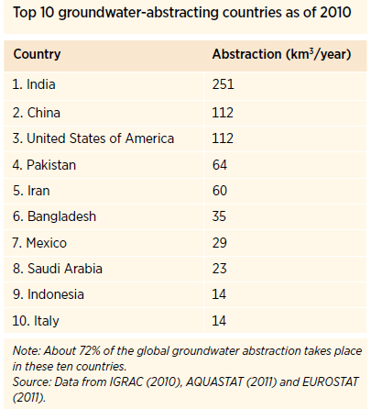
Sources of water
Groundwater significant source of water for human consumption:
  50% of drinking water
  43% of irrigation consumption
Global groundwater abstraction rate has tripled over the last 50 years.

Slide 17
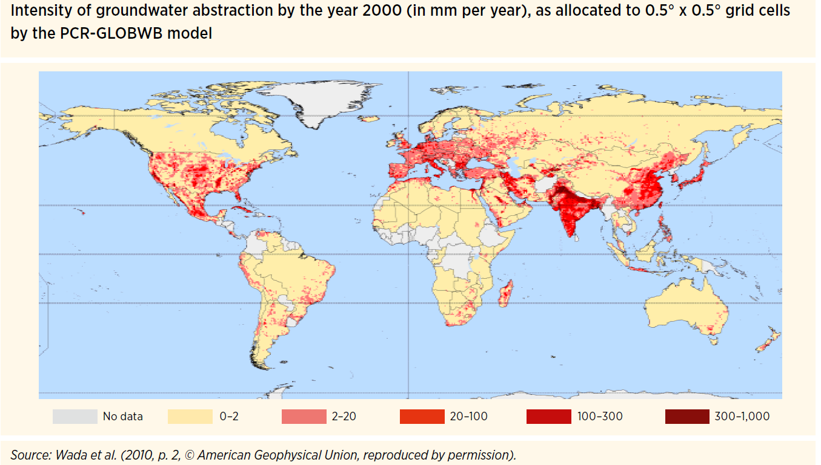
Sources of water
Notes:
Groundwater abstraction
<Foliennummer>

Slide 18
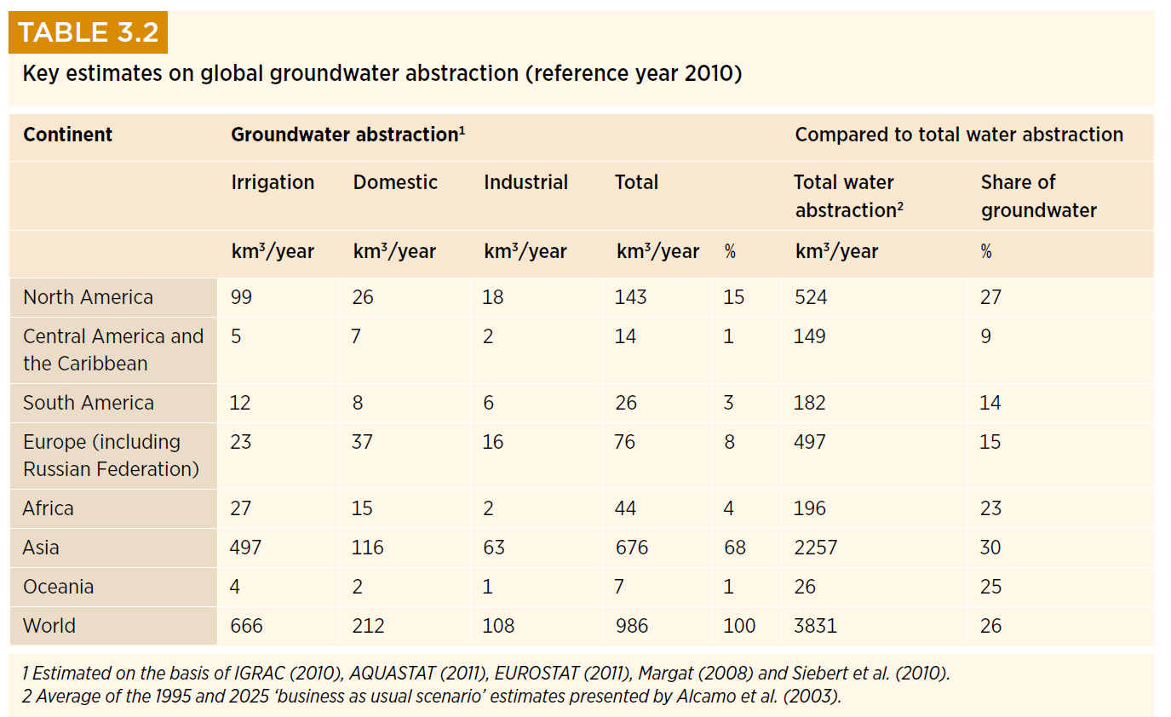
Sources of water
Source: Groundwater and Global Change: Trends, Opportunities and Challenges, UNESCO, 2012
Notes:
Water abstraction sources in the world
<Foliennummer>

Slide 19
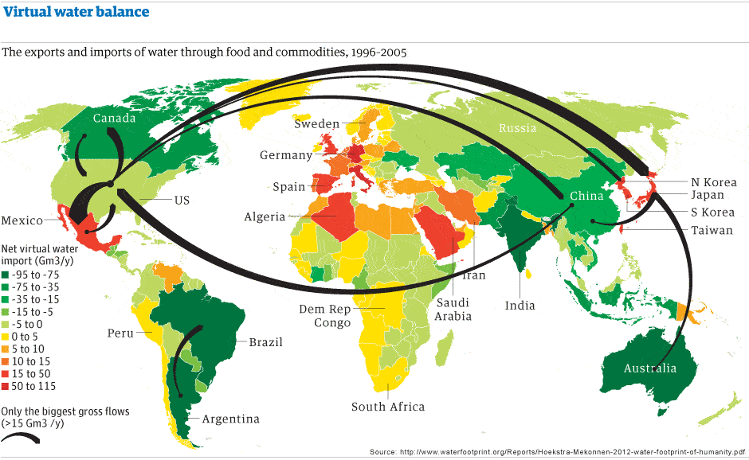
Virtual water Import/Exports
Notes:
Virtual water flows
<Foliennummer>

Slide 20
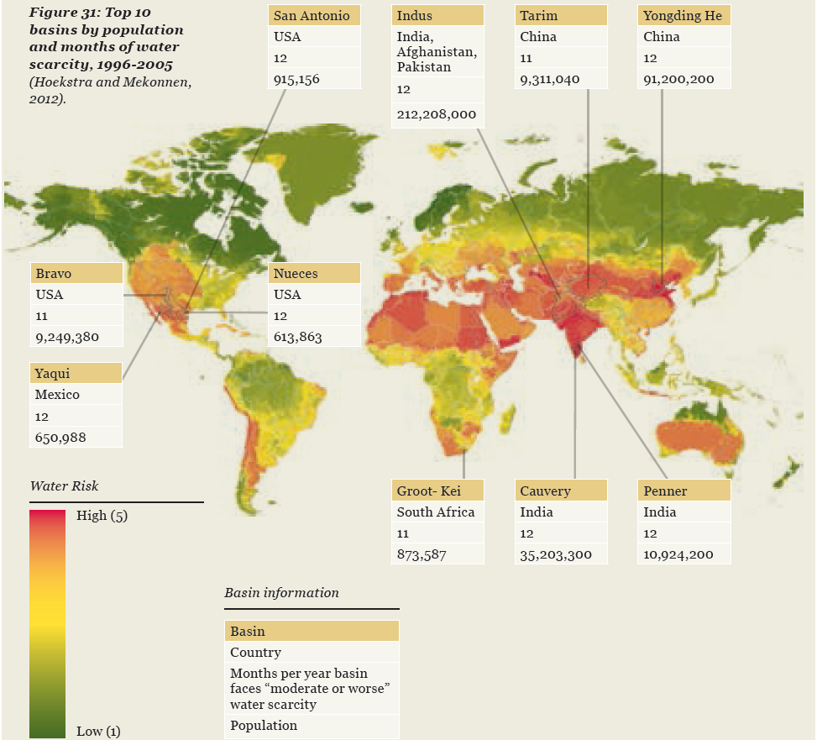
Water scarcity
Notes:
Water scarcity TOP 10
<Foliennummer>

Slide 21
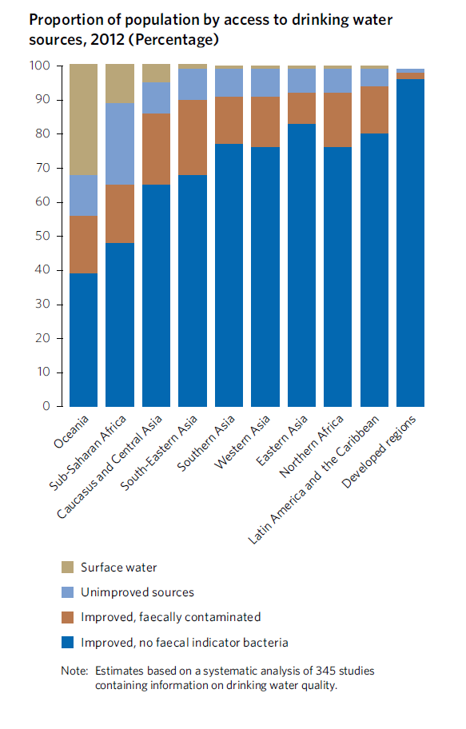
Notes:
Access to drinking water
<Foliennummer>

Slide 22
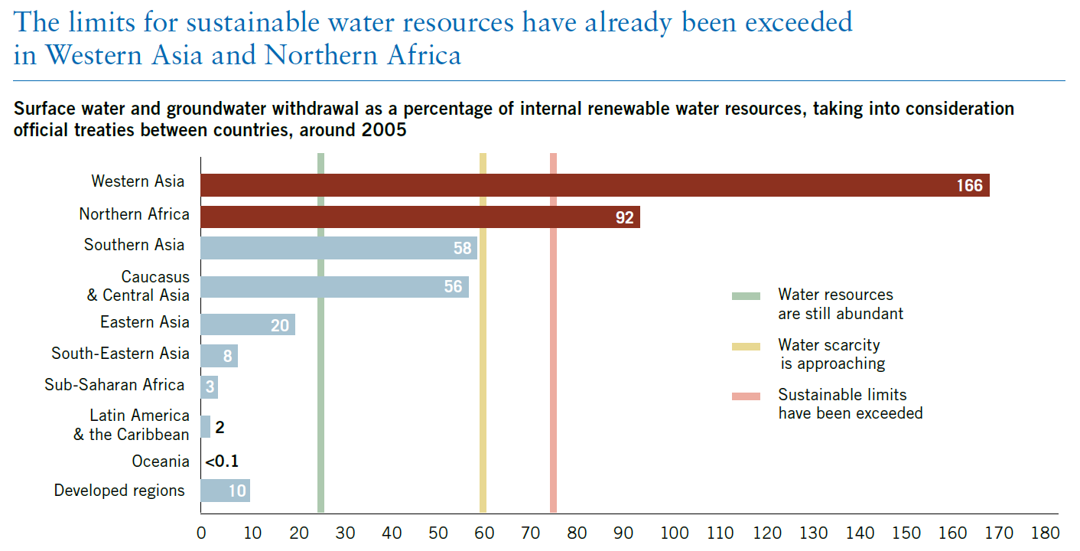
Waterstress
in West-Asia & North Africa
Source: United Nations: The Millenium Development Goals Report 2011, UN.org
Notes:
Groundwater withdrawl beyond the limits
<Foliennummer>

Slide 23
North – South Issues
Global south:
  1 Mio people without clean drinking water.
  6000 deaths caused by polluted drinking-water.
  Every 20 seconds a child dies as a result of poor sanitation.
Global north:
  Highest fresh-water-prices for tap water
  Average US-American spends 100$/year for bottled water.
  Average German consumer buys 143,5 l bottled water per year
Notes:
<Foliennummer>

Slide 24
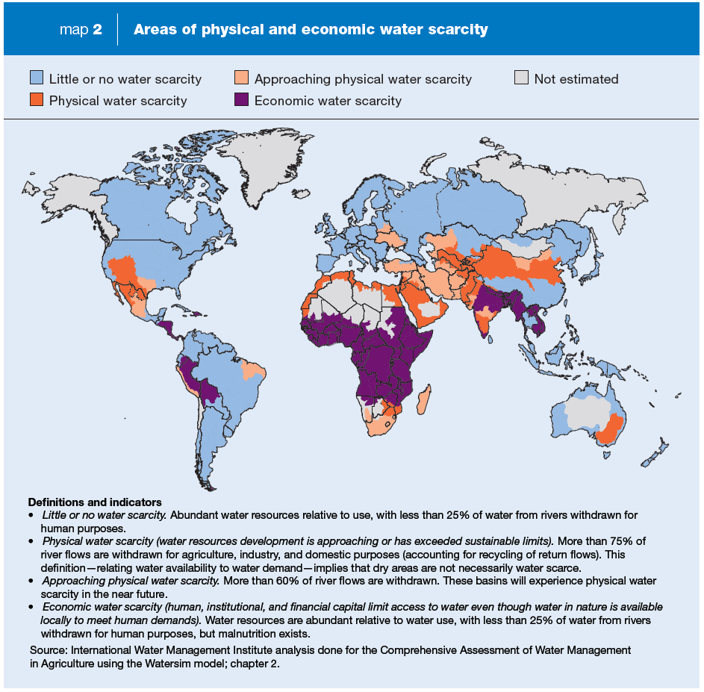
Notes:
Physical and economical water scarcity
<Foliennummer>

Slide 25
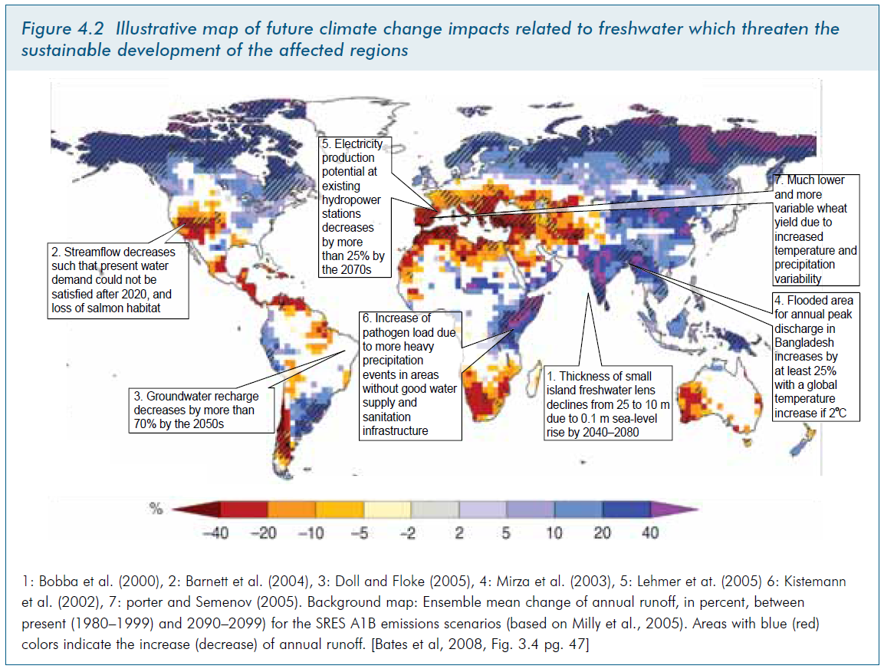
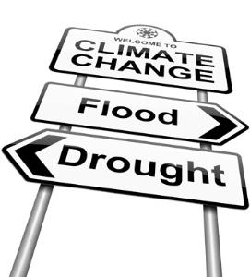
Water scarcity and climate change
Source: Water and climate change: Under- standing the risks and making climate-smart investment decisions, The World Bank, Water sector board, bnwpp, norwegian ministry of foreign affairs, 2009
Lower yields
Rivers decrease
Floods
Notes:
Climate change
<Foliennummer>

Slide 26
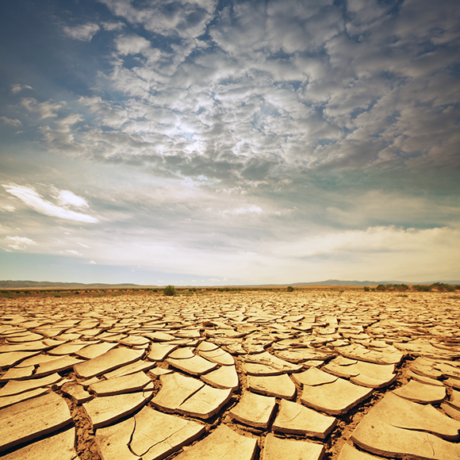
Proposed water deficits in 2030
Source: Water and climate change: Under- standing the risks and making climate-smart investment decisions, The World Bank, Water sector board, bnwpp, norwegian ministry of foreign affairs, 2009

Slide 27
EU politics
2000 EU Water Framework Directive (WFD)
  The WFD established the objective to achieve good status by 2015.
European Commission published reports:
  “River basin management plans”
  “Review of the European Water Scarcity and Droughts Policy”
  “A Blueprint to Safeguard Europe's Water Resources”

Slide 28

Right2water
EU citizens initiative “right2water.eu”
Duration: April 2012 – September 2013
1,88 Million signed it
First successful EU citizens initiative

Slide 29


United Nations
UN Water
The United Nations Inter-Agency machanism on all freshwater related issues, including sanitation
2005-2015 International Decade for Action “Water for life”
World Water Day
UNESCO-IHE
UN-Institute for water education
Water Centres

Slide 30
Post-2015 development agenda
Water targets:
Achieve universal access to safe drinking water, sanitation and hygiene
Improve by (x%) the sustainable use and development of water resources in all countries
All countries strengthen equitable, participatory and accountable water governance
Reduce wastewater pollution and improve water quality by reducing untreated domestic and industrial wastewater by (x%); increasing wastewater reused safely by (y%); and reducing nutrient pollution by (z%) to maximize water resource availability and improve water quality.
Reduce mortality by (x%) and economic loss by (y%) from natural and human-induced water- related disasters.

Slide 31


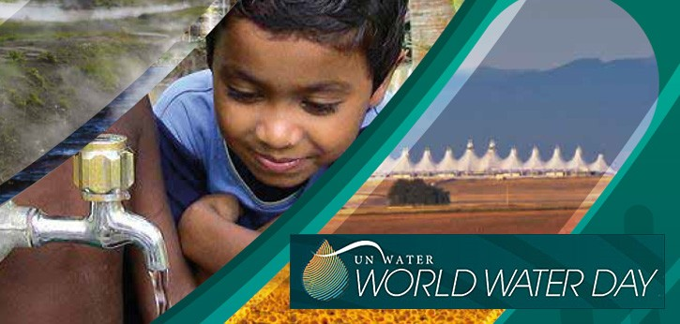
Sunday,
22. March

